Slide 1
Python and Dask

Slide 2
Overview
Dask was launched in late 2014 by Matthew Rocklin with aims to bring native scalability to the Python Open Data Science Stack and overcome its single-machine restrictions
Address:
Long run time in processing large dataset
Dask is a framework for general scalable distributed computing
Analyze and model large datasets

Slide 3
Datasets
Small datasets
Datasets that fit comfortably in RAM, leaving memory to spare for manipulation and transformations
These datasets are frequently encountered when learning data science, and tools like Pandas, NumPy, and scikit-learn are the best tools for the job.
usually no more than 2–4 GB
Medium datasets
Datasets that cannot be held entirely in RAM but can fit comfortably in a single computer’s persistent storage
typically range in size from 10 GB to 2 TB.
make sense to introduce parallelism to cut down processing time.

Slide 4
Large datasets are datasets that can neither fit in RAM nor fit in a single computer’s persistent storage.
typically, above 2 TB in size, and depending on the problem, can reach into petabytes and beyond.
Pandas, NumPy, and scikit-learn are not suitable at all for datasets of this size, because they were not inherently built to operate on distributed datasets.

Slide 5
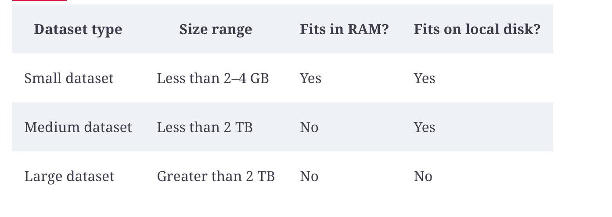

Slide 6
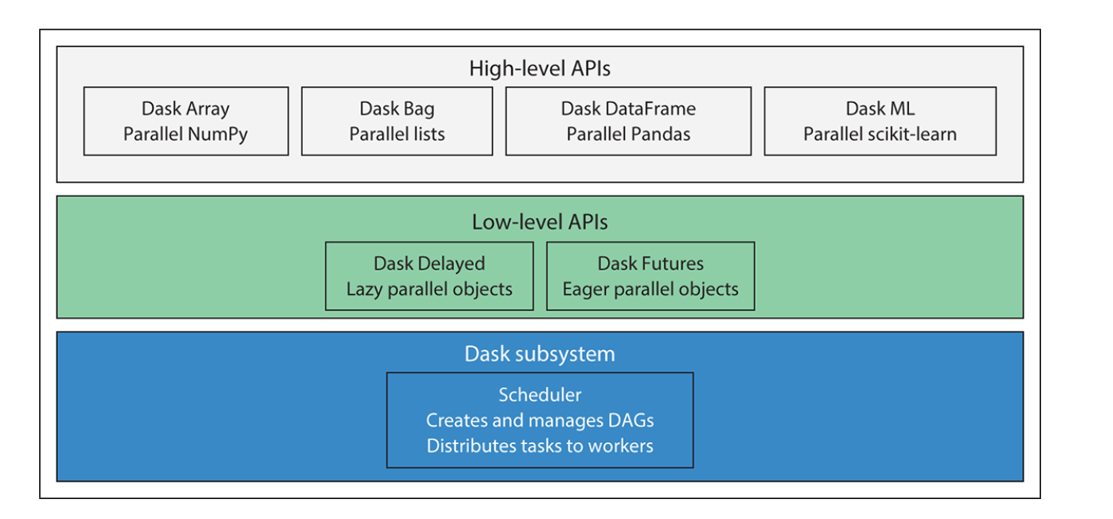
Dask components
Notes:
At the core is the task scheduler, which coordinates and monitors execution of computations across CPU cores and machines.
These computations are represented in code as either Dask Delayed objects or Dask Futures objects
key difference
Delayed object are evaluated lazily —they are evaluated just in time when the values are needed
Future objects are evaluated eagerly —meaning they are evaluated in real time regardless if the value is needed immediately or not
Dask’s high-level APIs offer a layer of abstraction

Slide 7
Dask advantages
Dask is fully implemented in Python and natively scales NumPy, Pandas, and scikit-learn.
Dask can be used effectively to work with both medium datasets on a single machine and large datasets on a cluster.
Dask can be used as a general framework for parallelizing most Python objects.
Dask has a very low configuration and maintenance overhead.

Slide 8
Natively scale NumPy, Pandas and Scikit-learn
written and implemented entirely in Python, and its collection APIs natively scale NumPy
Dask DataFrame is made up of many smaller Pandas DataFrames, a Dask Array is made up of many smaller NumPy Arrays, and so forth.
Each of the smaller underlying objects, called chunks or partitions, can be shipped from machine to machine within a cluster, or queued up and worked on one piece at a time locally.
Don’t need to learn a new syntax, data scientist – focus on writing robust, optimized code

Slide 9
working on medium or small dataset on a single machine or large dataset on a cluster
Useful to prototype on local machines and submit tasks to clustering
Without refactor/rewrite existing code or additional code to run on a cluster
Built in task scheduler
Local scheduler for local machine, distributed scheduler for cluster
Interface popular resource manager – YARN, Mesos and Kubernetes to use existing task scheduler
Notes:
Overhead in running on a cluster. For medium dataset, can run locally.

Slide 10
Ability to scale python objects
Dask Delayed and Dask Future –
scale NumPy arrays used in Dask Array
Pandas DataFrame used in Dask DataFrame
Python lists used in Dask Bag

Slide 11
Dask is lightweight, easy to set up, tear down and maintain
Use pip or conda to install dependencies
Build and deploy cluster worker images using Docker
Ideal for
Recurring job
Ad hoc data analysis
Building proofs of concept

Slide 12
Dask and Spark
Spark
support many languages
In memory alternative to MapReduce
Popular framework to handle large datasets
Use legacy Java libraries, rely on Java Virtual Machine (JVM)
Interacts with Spark cluster using Python
Must pass through the JVM using Py4J library. Make it difficult to debug PySpark
More difficult to setup and configure, require more dependencies such as Apache ZooKeeper

Slide 13
Dask
Shorter learning curve
Familiar API
flexibility

Slide 14
Directed Acyclic Graph (DAG)
To compose, control, and express computations.
Come from graph theory in mathematics
graph as a representation of a set of objects that have a relationship with one another.
Use to model a process such as cooking
Notes:
Cooking example

Slide 15
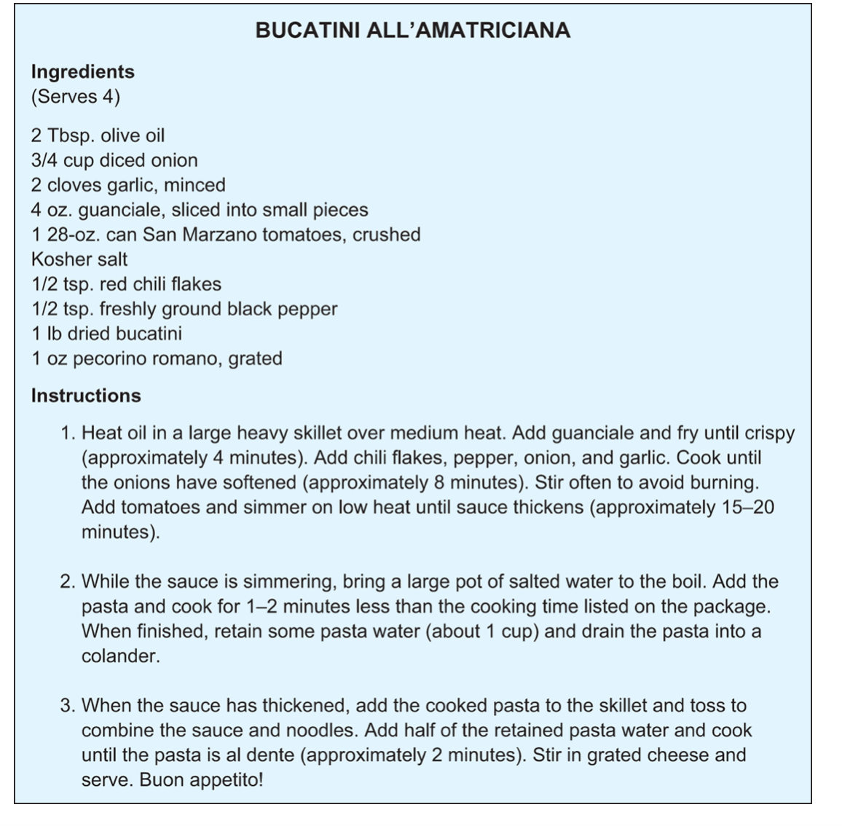
Notes:
Recipes – many sequential steps (functions), combining all ingredients into a final dish
Dice a whole onion into small pieces – function
Each of these functions – represent as a node in graph
Each node can help dependencies – a prior step must complete first
Sautee onion is directly dependent on dicing onion. The 2 nodes are connected by a line

Slide 16
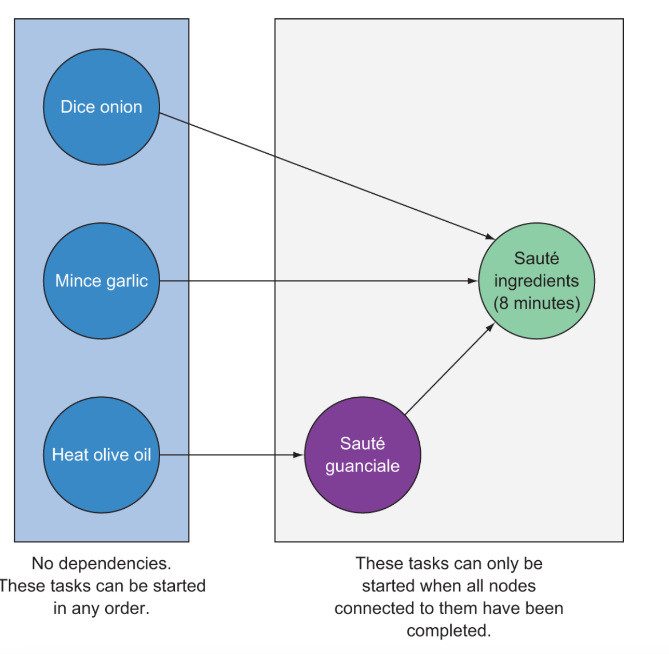
Notes:
Sauté Ingredients node has three direct dependencies: the onion and garlic must be diced and the guanciale must be sautéed before the three ingredients can be sautéed together.
Dice Onion, Mince Garlic, and Heat Olive Oil nodes do not have any dependencies. The order in which you complete those steps does not matter,
must complete all of them before proceeding to the final sauté step.
Also notice that the lines connecting the nodes have arrows as endpoints. This implies that there is only one possible way to traverse the graph.
directed acyclic graph: there’s a logical, one-way traversal through the graph from nodes with no dependencies to a single terminal node.
No feedback loop (acyclic)

Slide 17
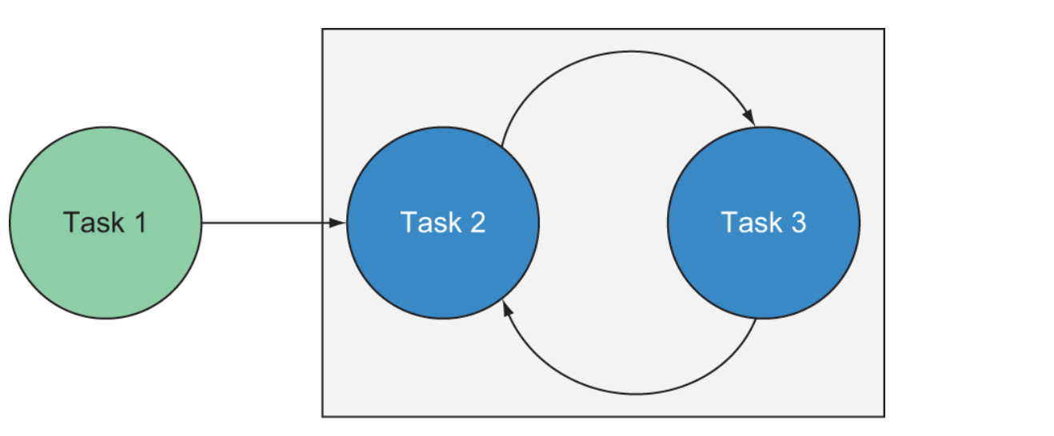
Notes:
Cyclic loop - If the graph contained a feedback loop or some kind of continuous process, it would instead be a cyclic graph.

Slide 18
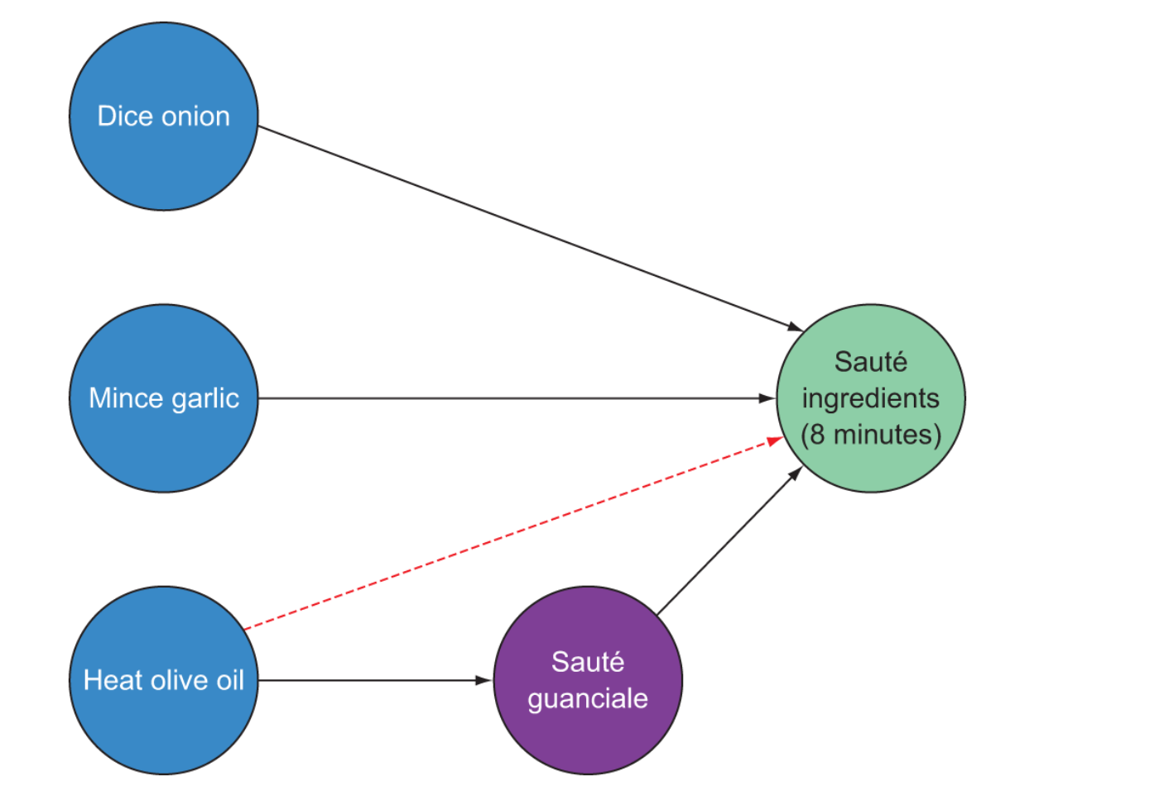
Transitive reduction in DAG
Notes:
This means that any lines that express transitive dependencies are eliminated. A transitive dependency simply means a dependency that is met indirectly through completion of another node
Implies sautee ingredients indirectly dependent on heating olive oil

Slide 19
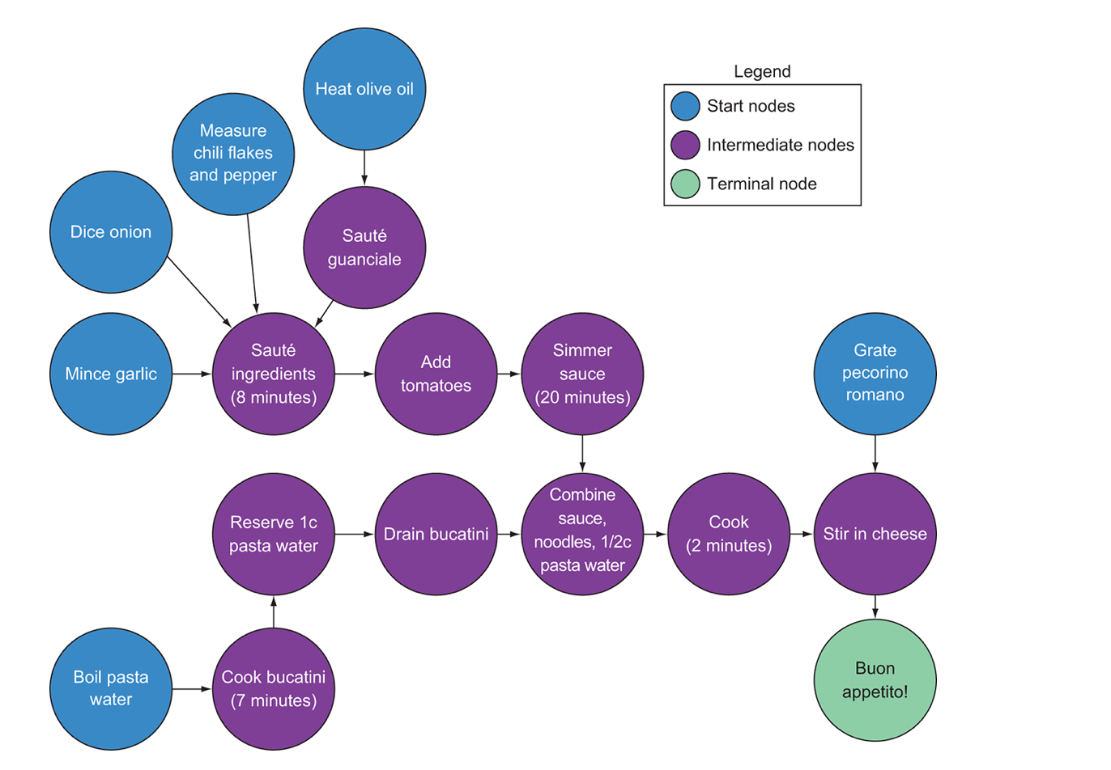
The full DAG representation of the recipe

Slide 20
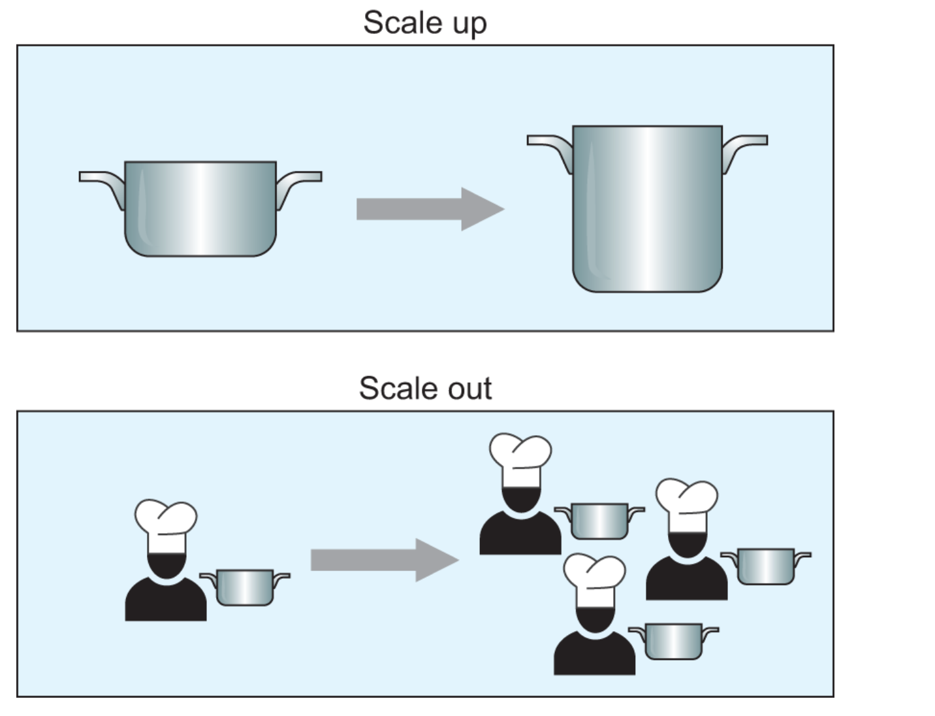
Scale up or scale out
Notes:
Assume you are the only cook.
How about cooking in a restaurant
Think about – upgrade equipment or hiring more cook (scale up and scale out)
Here, we consider scale out (more workers) – using Dask.
Scale up – oversee the whole process with powerful equipment – eventually outgrow the industrial size food processor and kitchen technology.
Now hire 9 cooks to share the workload.
Generalized worker – can assists in all necessary tasks. Trade-off: workers can get sick, miss work
Eventually need a hire a chief chef to coordinate – similar: real coast to maintain a cluster, and should be evaluated.

Slide 21
How DAG help to plan and orchestrating complex tasks
how to relay instructions to each cook and make sure the recipe comes out as intended
DAG – plan or orchestrate complex task from a pool of workers
Dependencies between nodes help to coordinate workflow
A node - a standalone unit of work, so it’s possible to subdivide the work and share it among many worker
Notes:
e.g. 4 cooks to chop onion, 4 cooks to sautee to subdivide the task
Dividing and supervising the work in the kitchen is the job of the sous chef – task scheduling
As each cook completes their task, the sous chef can assign them the next available task.
To keep food moving efficiently in the kitchen, sous chef should constantly evaluate what work needs to be done and aim to start tasks closest to the terminal node ASAP
for example, rather than waiting for all 100 onions to be chopped, if enough onions, garlic, and guanciale have been prepared to begin making a complete batch of sauce, the sous chef should tell the next available cook to begin preparing a batch of sauce.
Dask’s task scheduler aims to cycle workers between many tasks in order to reduce memory

Slide 22
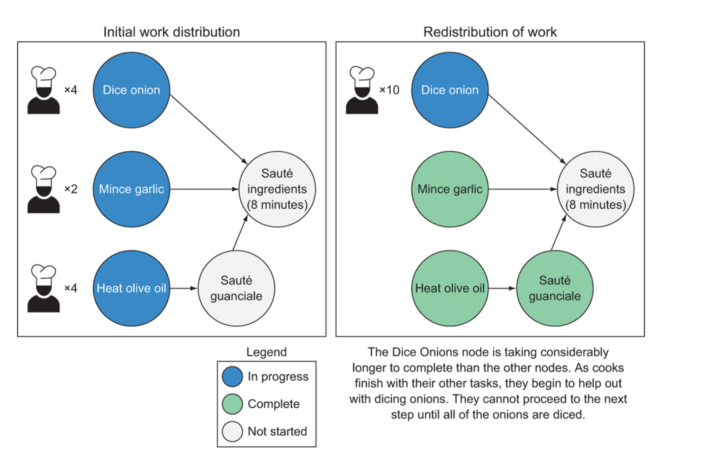
Possible way the original graph can be redistributed
Notes:
Dask’s task scheduler aims to cycle workers between many tasks in order to reduce memory
It distributes units of work to machines in an efficient manner and aims to minimize the worker pool’s idle time.

Slide 23
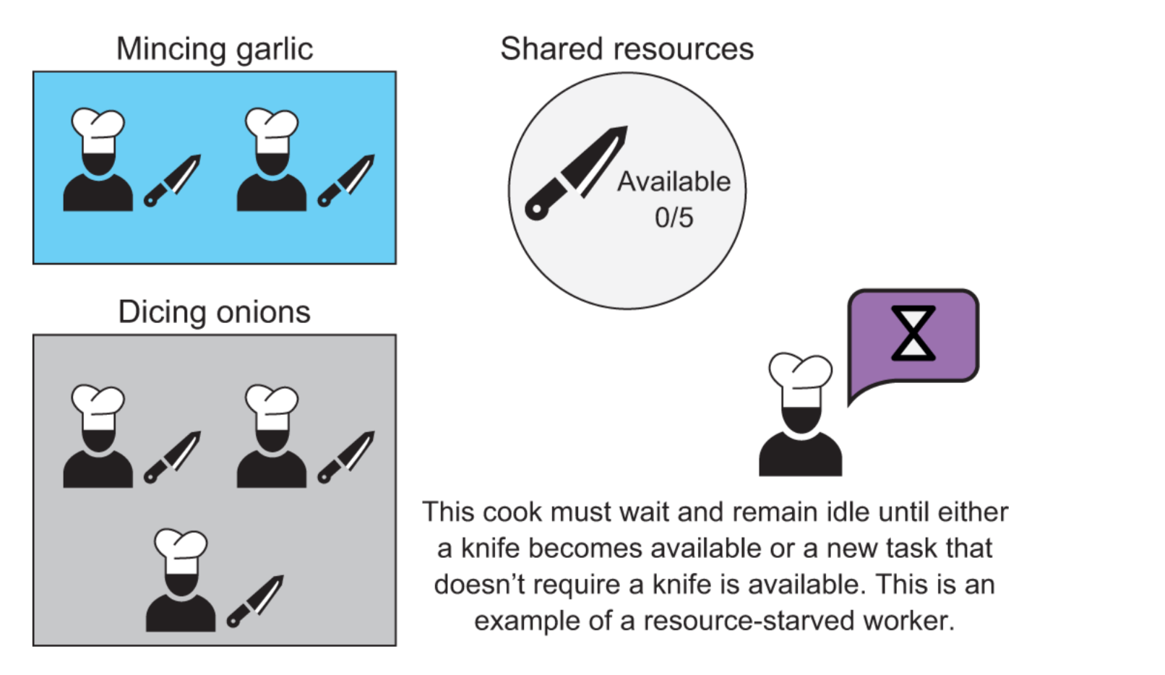
Concurrency and resource management
In scalable computing, these are called issues of concurrency.
Example of resource starvation
Notes:
if you hire more cooks to dice onions, but you only have five knives in the kitchen, only five operations that require a knife can be carried out simultaneously
Therefore, if all five knives are in use by cooks dicing onions, the garlic can’t be minced until at least one knife becomes available
Even if the remaining five cooks have completed all other possible nodes, the garlic-mincing step becomes delayed due to resource starvation.
When a shared resource is in use, a resource lock is placed on it
The sous chef is responsible for defusing these confrontations by laying the ground rules about who can use certain resources and what happens when a resource becomes available

Slide 24
Recovering from failures
Failure
Worker failure without data loss
Worker failure with data loss
Data loss
complete lineage of operations up to a given node can be “replayed” in the event of a failure.
The task scheduler is ultimately responsible for stopping work and redistributing the work to be replayed.
Task scheduler fail - re-create the DAG
Notes:
Since the final result consists of the aggregate of all the individual operations, it’s important to ensure that all the pieces find their way to where they need to go.
2 types of failure in machine – data loss and worker failure
Worker failure without data loss - For example, if a cook decides to quit in the middle of cooking, the other worker step out and continue from what was left off
Data loss – knock over the sauce on the floor, can’t reuse. Go back to dicing onion, Sautee…

Slide 25
Summary
Dask can be used to scale popular data analysis libraries such as Pandas and NumPy, allowing you to analyze medium and large datasets with ease.
Dask uses directed acyclic graphs (DAGs) to coordinate execution of parallelized code across CPU cores and machines.
Directed acyclic graphs are made up of nodes and have a clearly defined start and end, a single traversal path, and no looping.
Upstream nodes must be completed before work can begin on any dependent downstream nodes.
Scaling out can generally improve performance of complex workloads, but it creates additional overhead that might substantially reduce those performance gains.
In the event of a failure, the steps to reach a node can be repeated from the beginning without disturbing the rest of the process.

Slide 26
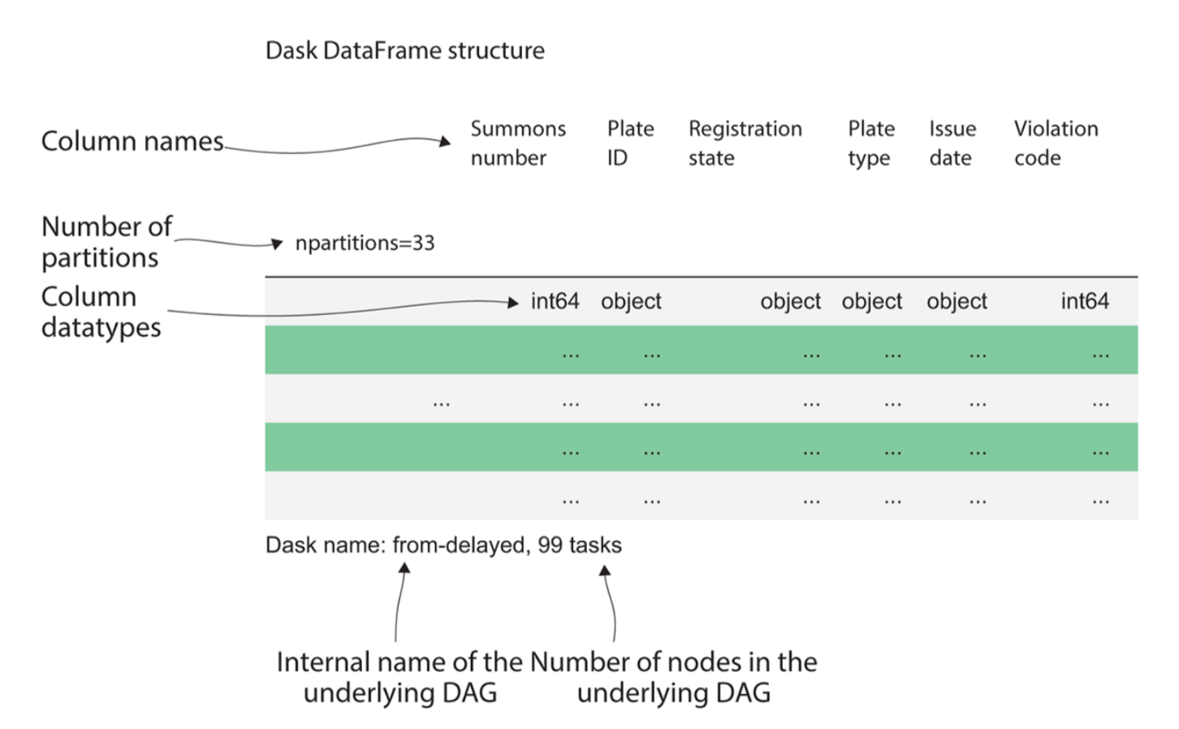
dataset
Every third week of the month, the New York City Department of Finance records and publishes a data set of all parking citations issued throughout the fiscal year so far.
The dataset spans from 2013 through June 2017 and is over 8 GB uncompressed.
Notes:
https://opendata.cityofnewyork.us, https://data.cityofnewyork.us/browse?q=parking+ticket
https://data.cityofnewyork.us/City-Government/Parking-Violations-Issued-Fiscal-Year-2014/jt7v-77mi
https://dev.socrata.com/foundry/data.cityofnewyork.us/jt7v-77mi
OR
https://www.kaggle.com/datasets/new-york-city/nyc-parking-tickets
https://www.kaggle.com/code/msigaeva/starter-nyc-parking-tickets-74d324be-2/data/Parking_Violations_Issued_-Fiscal_Year_2014__August_2013__June__2014.csv

Slide 27
objectives
A short example of data cleaning using Dask DataFrames
Visualizing DAGs generated by Dask workloads with graphviz
Exploring how the Dask task scheduler applies the concept of DAGs to coordinate execution of code

Slide 28
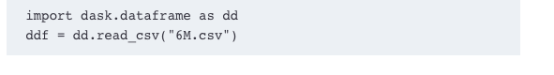
Read a single file
Notes:
Dask DataFrames (ddf)

Slide 29
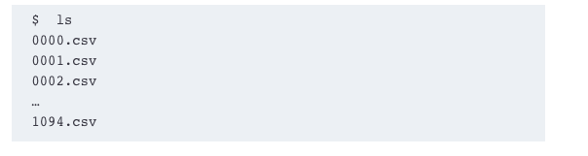
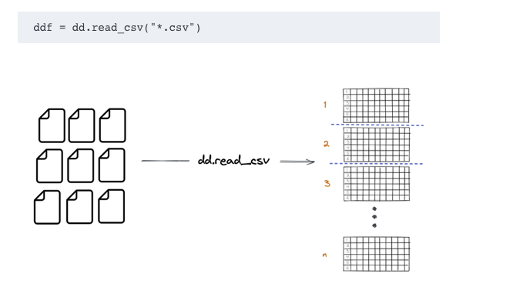
Read multiple files
Notes:
Dask DataFrame let’s you use * as a glob string to read all of these separate CSV files into a Dask DataFrame at once

Slide 30
Using the NYC parking citation / ticket dataset, learn:
Dask DataFrame API to analyze a structured dataset
few useful diagnostic tools
low-level Delayed API to create a simple custom task graph
Notes:
Dask uses DAGs to create robust, scalable workloads

Slide 31
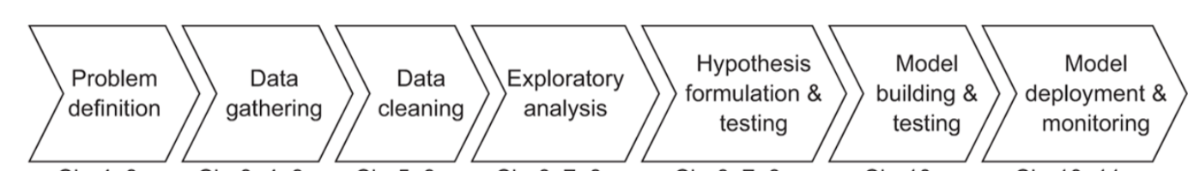
Common data science task

Slide 32
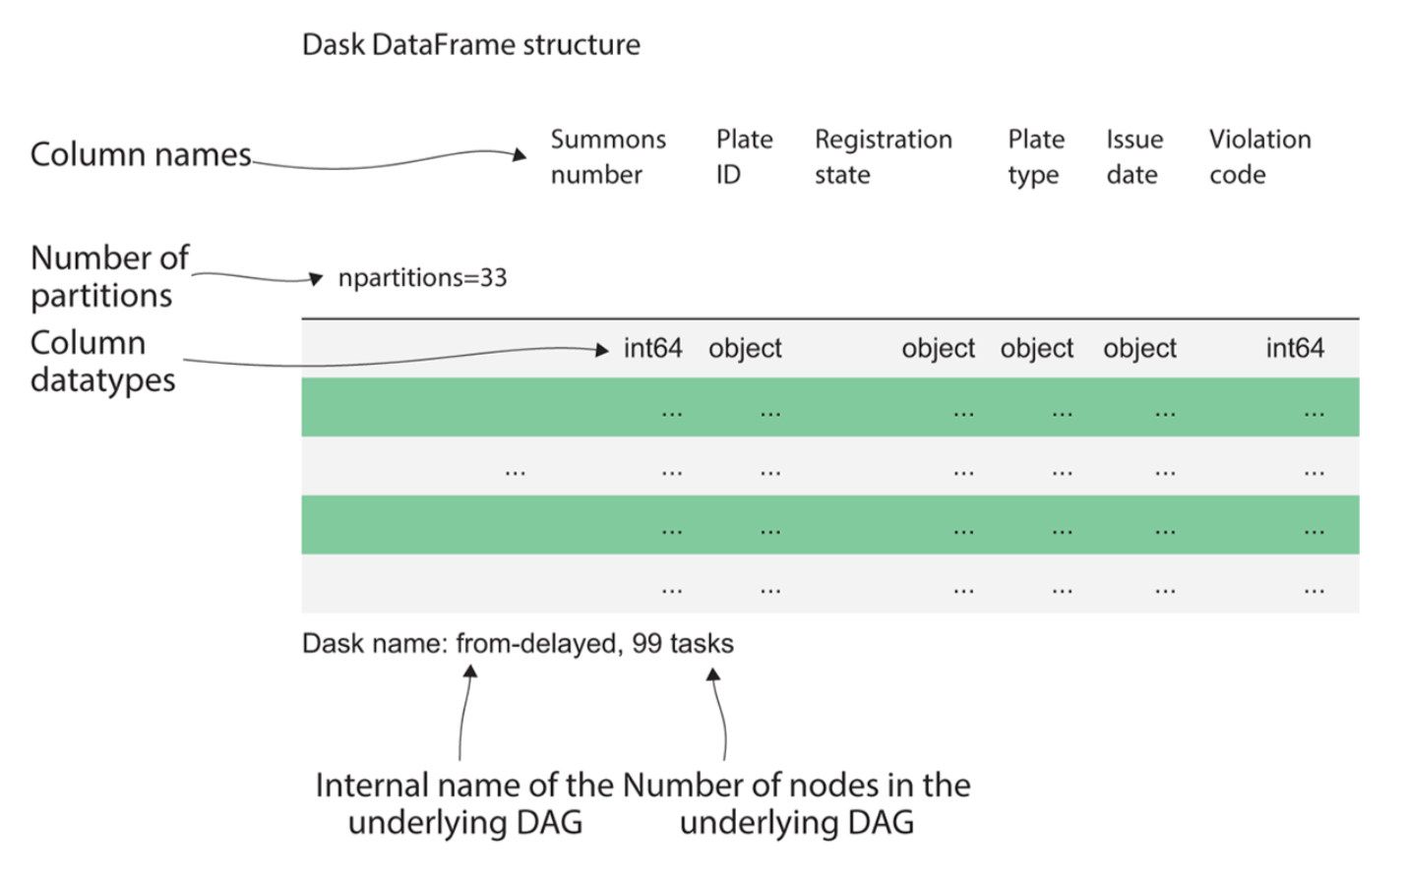
Notes:
While Pandas would display a sample of the data, when inspecting a Dask DataFrame, we are shown the metadata of the DataFrame.
The column names are along the top, and underneath is each column’s respective datatype.
Dask tries to intelligently infer datatypes from the data,
Dask was built to handle medium and large datasets that can’t be loaded into RAM at once.
DataFrames employ random sampling methods to profile and infer datatypes from a small sample of the data.
a single anomalous row among millions or billions of rows, it’s very improbable that the anomalous row would be picked in a random sample.
This will lead to Dask picking an incompatible datatype, which will cause errors later on when performing computations.
best practice to avoid that situation would be to explicitly set datatypes rather than relying on Dask’s inference process.
Parquet - storing data in a binary file format that supports explicit data types,
The npartitions value shows how many partitions the DataFrame is split into.

Slide 33
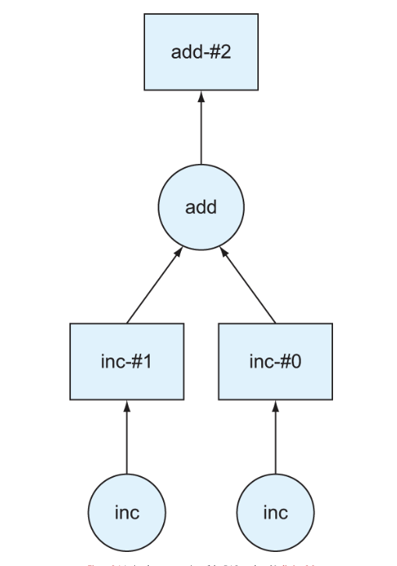
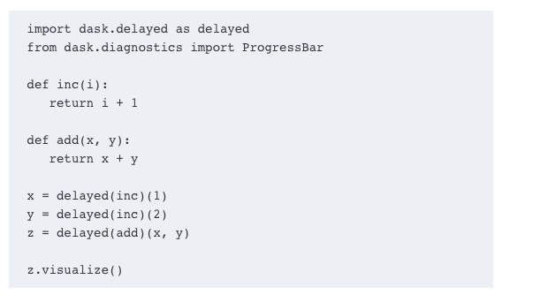
DAG example

Slide 34
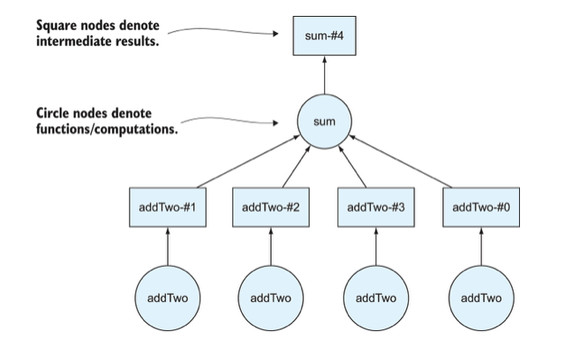
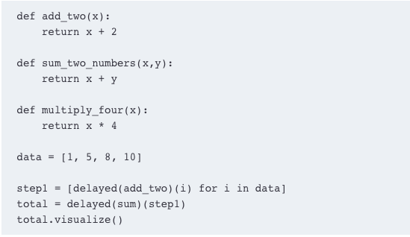
Notes:
Dask draws DAGs from the bottom up. We started with four numbers in a list called data, which corresponds to four nodes at the bottom of the DAG.
The circles on the Dask DAGs represent function calls. ( 4 numbers)
we wanted to apply the add_two function to each number so we have to call it four times.
we call the sum function only one time because we’re passing in the complete list.

Slide 35
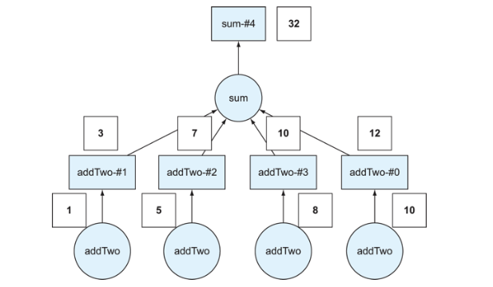

Slide 36
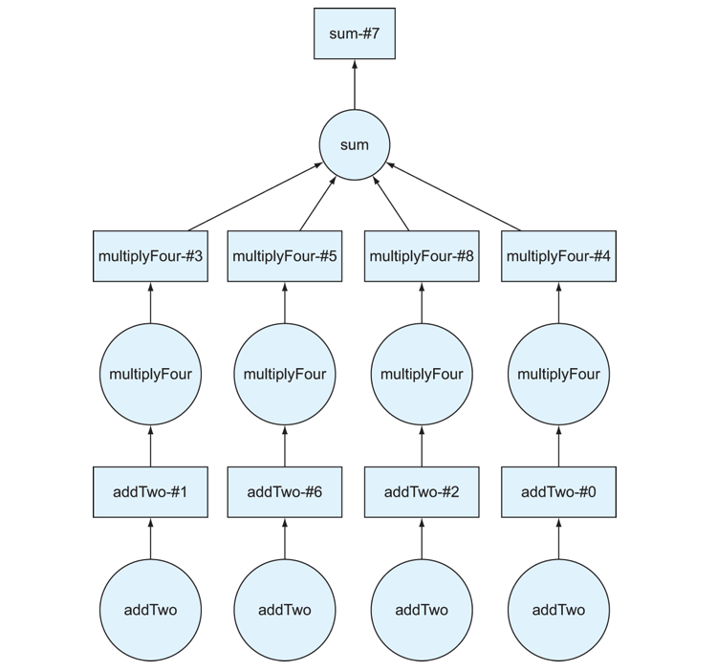
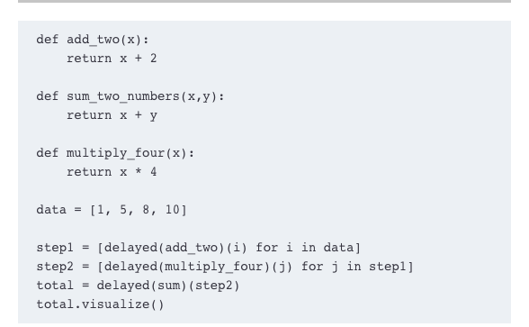
Multiply each number by 4

Slide 37
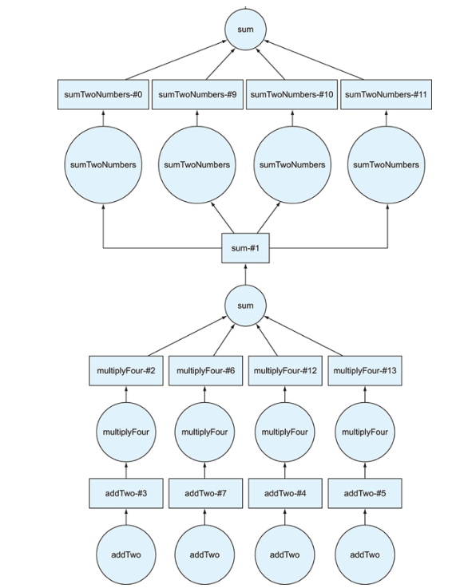
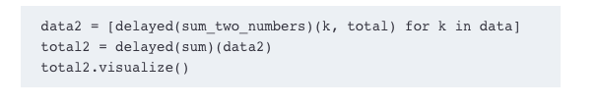
Add another layer
Notes:
Dask won’t

Slide 38
Exercise
Dask2.ipynb

Slide 39
Objectives
Defining structured data and determining when to use Dask DataFrames
Exploring how Dask DataFrames are organized
Inspecting DataFrames to see how they are partitioned
Dealing with some limitations of DataFrames
Notes:
Previous chapter, how Dask uses DAG to manage complex tasks across multiple machines
Look at Dask API and NYC parking violation dataset

Slide 40
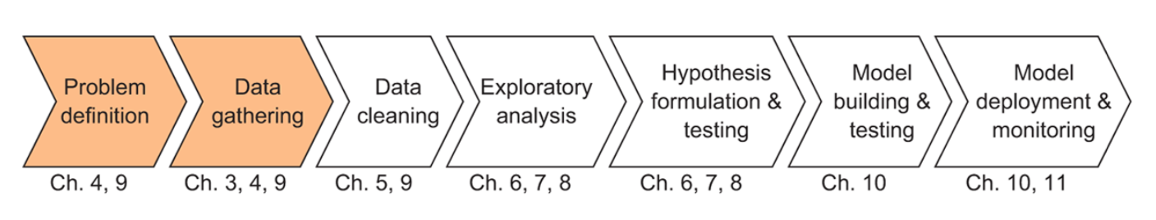
Data science and Dask workflow
Notes:
Dask DataFrames wrap Delayed objects around Pandas DataFrames to allow you to operate on more sophisticated data structures.
DataFrames API : joins, grouping operations, and so on, that are useful for common data manipulation tasks.
Dask can support parallel processing and handle large datasets by chunking data into smaller pieces called partitions

Slide 41
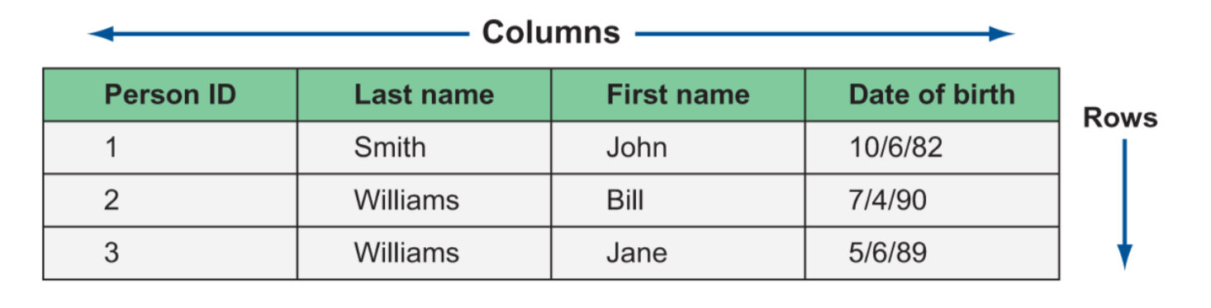
Structured data – rows, columns
Notes:
Keep related information together
Row (observation) : logical entity (e..g person)
Column (attribute) : things we know about the person
Filter person by location/state, age …

Slide 42
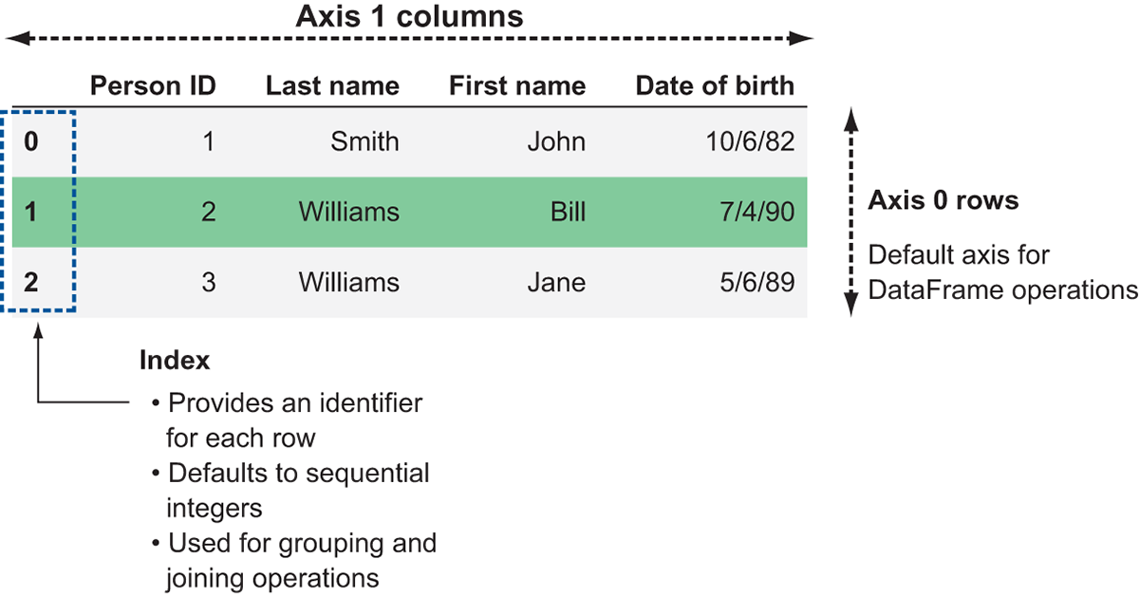
Data frame
Similar to structured data
Notes:
Row – axis 0 (x-axis) / column – axis 1 (y-axis)
Dask does not enforce uniqueness, so you can have duplicate indices if necessary.
By default, DataFrames are created with a sequential integer index
You can specify your own index
hold the key to distributing DataFrame workloads across clusters of machines

Slide 43
Dask and pandas
Pandas – not design with scalability in mind
Good for small datasets
Load in memory, handle one row at a time
Dask API - providing a wrapper around Pandas that intelligently splits huge data frames
Different pieces of the DataFrame that Dask oversees are called partitions.
can split the data into multiple partitions, allowing the workload to be parallelized
complete the work more efficiently by spreading the work out over multiple machines

Slide 44
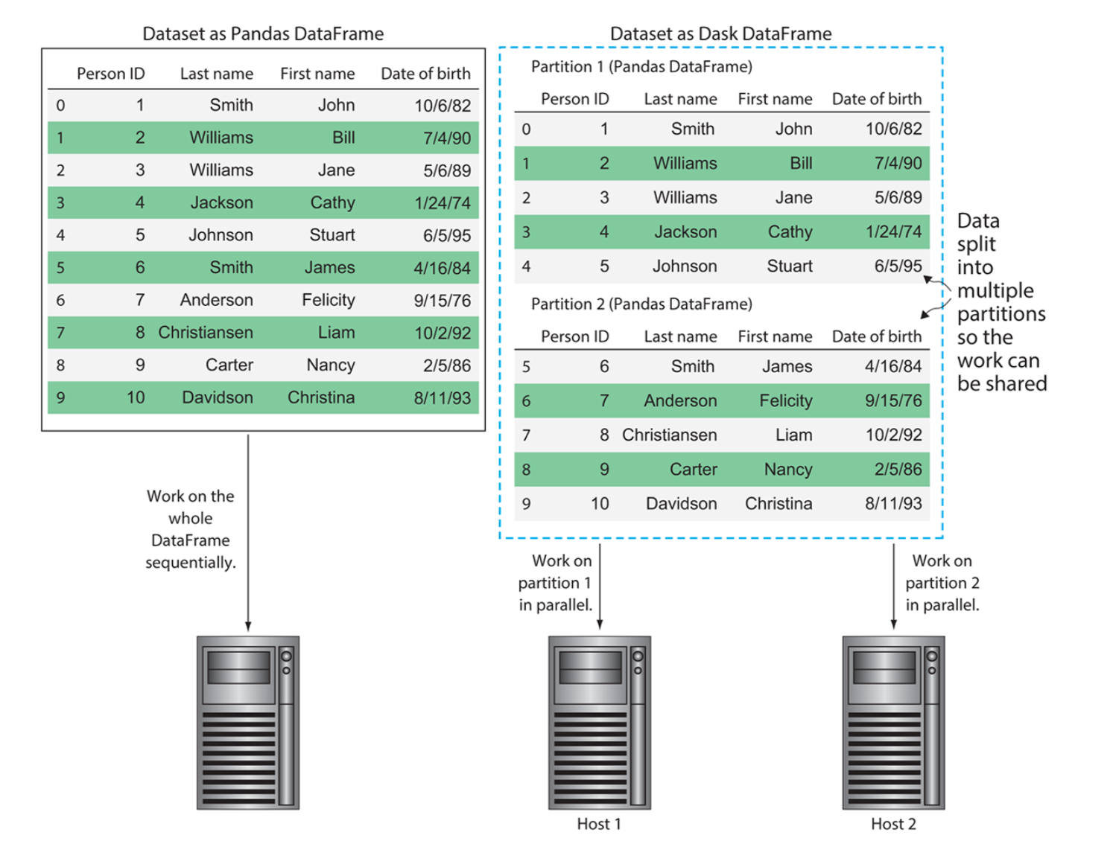

Slide 45
Managing DataFrame partitioning
read_csv method of Dask DataFrames, the default partition size is 64 MB each (this is also known as the default blocksize
Can be user specified
64 MB –
small enough that it can be quickly transported over the network if necessary
but large enough to minimize the likelihood that a machine will run out of things to do while waiting for the next partition to arrive.

Slide 46
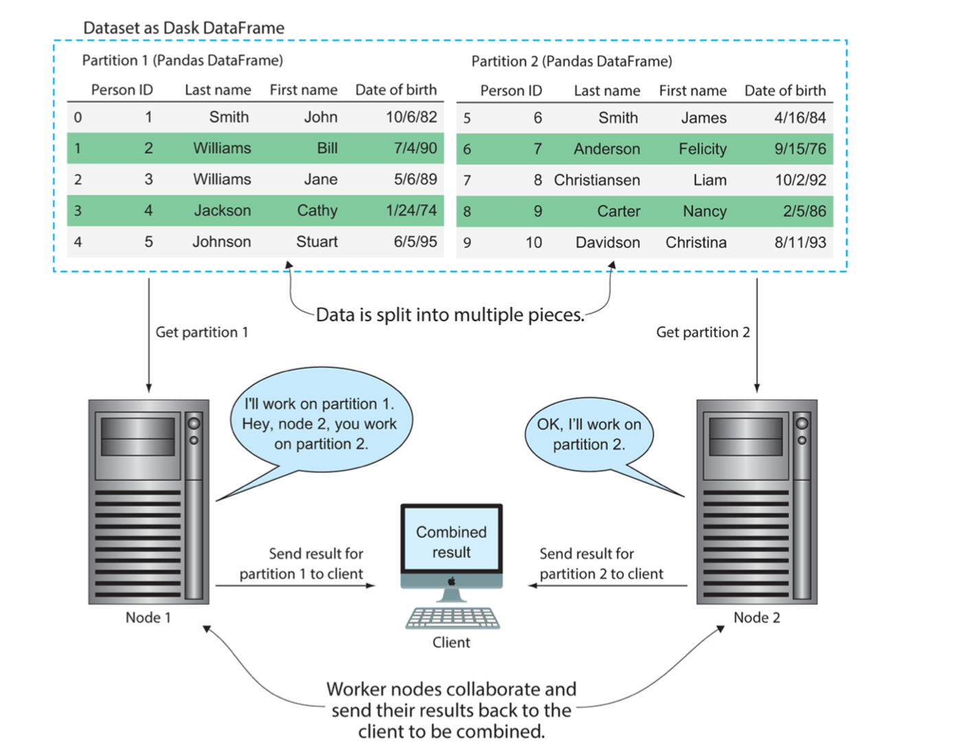
Processing data across multiple machines
Notes:
If you desire to create a DataFrame with a specific number of partitions instead, you can specify that when creating the DataFrame by passing in the npartitions argument.

Slide 47
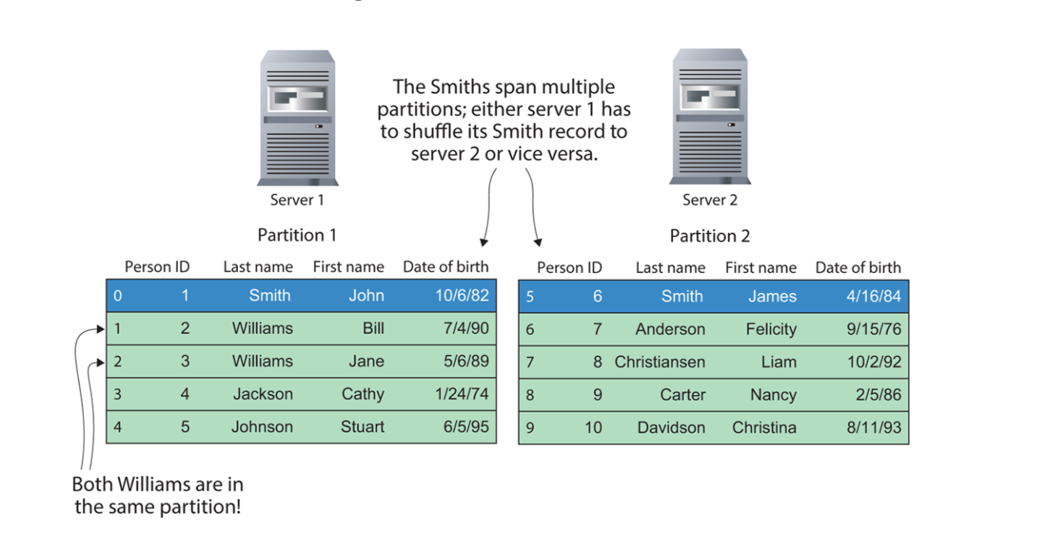
Shuffle
shuffle is the process of broadcasting all partitions to all workers
Shuffle is necessary for groupBy operation
Notes:
Shuffling the data is necessary when performing sorting, grouping, and indexing operations
because each row needs to be compared to every other row in the entire DataFrame to determine its correct relative position.
This is a time-expensive operation, because it necessitates transferring large amounts of data over the network. Let’s see what this might look like.
group our data by Last Name, find the eldest person by lastname
Dask to be able to compare the birthdates of each Smith, one of them will have to be shipped over the network.

Slide 48
Avoid shuffling if possible
First, ensuring that the data is stored in a presorted order will eliminate the need to sort the data with Dask.
sorting the data in a source system, such as a relational database, can be faster and more efficient than sorting the data in a distributed system.
if you must use an operation that triggers a shuffle, persist the result if you have the resources to do so.
Notes:
Shuffling is expensive and time consuming
sorting the data in a source system, such as a relational database, can be faster and more efficient than sorting the data in a distributed system.
prevent having to repeat shuffling the data again if the DataFrame needs to be recomputed.

Slide 49
Limitation of Dask DataFrame
Some functions that Pandas does well are simply not conducive to a distributed environment.
Dask DataFrames do not expose the entire Pandas API
Pandas insert and pop - not support in Dask since Dask DataFrame are immutable
stack/unstack and melt, because of their tendency to cause a lot of data shuffling.
with relational-type operations, such as join/merge, groupby, and rolling. Although these operations are supported, they are likely to involve a lot of shuffling
Notes:
Can have Dask perform data prep, filtering, and dump it to Pandas.
using Dask to prepare a smaller dataset that can be dumped into Pandas, or by limiting these operations to only use the index. For example, if we wanted to join a DataFrame of people to a DataFrame of transactions, that computation would be significantly faster if both datasets were sorted and indexed by the Person ID. This would minimize the likelihood that each person’s records are spread out across many partitions, in turn making shuffles more efficient.

Slide 50
indexing has a few challenges due to the distributed nature of Dask
since a Dask DataFrame is made up of many Pandas DataFrames, operations that are inefficient in Pandas will also be inefficient in Dask. For example, iterating over rows by using the apply and iterrows methods is notoriously inefficient in Pandas.
Notes:
you wish to use a column in a DataFrame as an index in lieu of the default numeric index, it will need to be sorted.
If the data is stored presorted, this becomes no problem at all. If the data is not presorted, it can be very slow to sort the entire DataFrame because it requires a lot of shuffling.
Effectively, each partition first needs to be sorted, then needs to be merged and sorted again with every other partition.
Sometimes it may be necessary to do this, but if you can proactively store your data presorted for the computations you need, it will save you a lot of time.

Slide 51
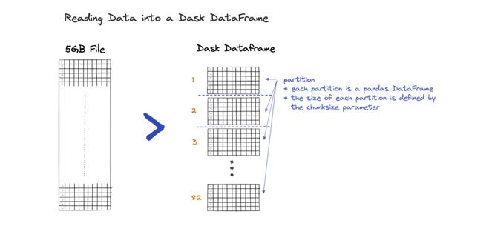
Partitions
ddf.partitions – show number of partitions

Slide 52
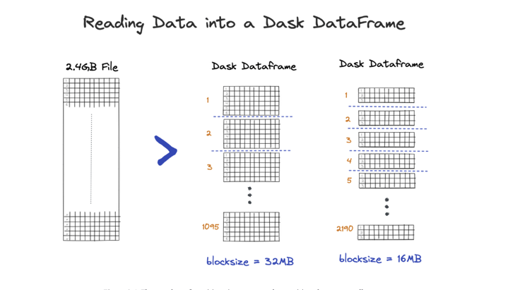
Set blocksize
ddf = dd.read_csv("*.csv", blocksize="16MB")
Ddf.partitions

Slide 53
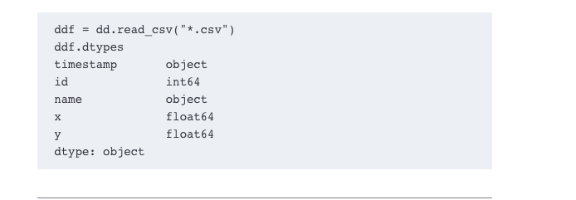
Inspecting data frames
Notes:
ou should be aware that inferring data types based on a sample of the rows is error-prone. Dask may incorrectly infer data types based on a sample of the rows which will cause downstream computations to error out.

Slide 54
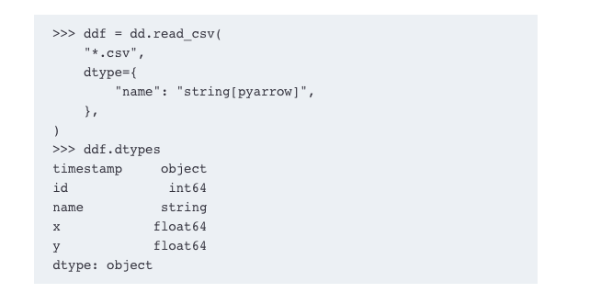
Manually set the data type

Slide 55
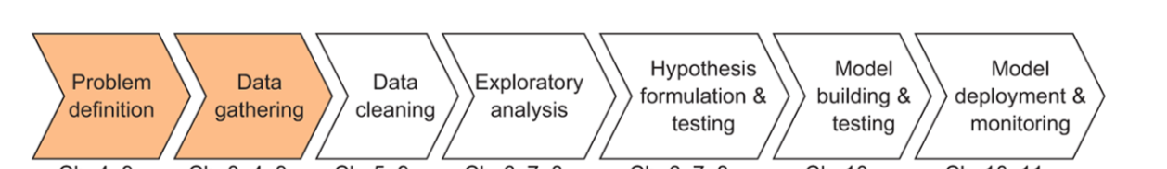
Loading data in data frame
Creating DataFrames from delimited text files and defining data schemas
Extracting data from a SQL relational database and manipulating it using Dask
Reading data from distributed filesystems (S3 and HDFS)
Working with data stored in Parquet format

Slide 56
Tradition data collection - in which data is carefully and thoughtfully collected.
As a data scientist
come across a wide variety of storage media and data formats
DataFrame API’s ability to interface with a very large number of data collection and storage systems
Recap:
Dask DataFrames we will create are made up of many small Pandas DataFrames that have been logically divided into partitions.
All operations performed on the Dask DataFrame result in the generation of a DAG (directed acyclic graph) of Delayed objects which can be distributed to many processes or physical machines.
Task scheduler controls the distribution and execution of the task graph.

Slide 57
Delimited Text file
has two types of delimiters: row delimiters and column delimiters.
A row delimiter is a special character that indicates that you’ve reached the end of a row, and any additional data to the right of it should be considered part of the next row. The most common row delimiter is simply a newline character (\n) or a carriage return followed by a newline character (\r\n).
a column delimiter indicates the end of a column, and any data to the right of it should be treated as part of the next column. Of all the popular column delimiters out there, the comma (,) is the most frequently used.
Notes:
Column delimiter - !

Slide 58
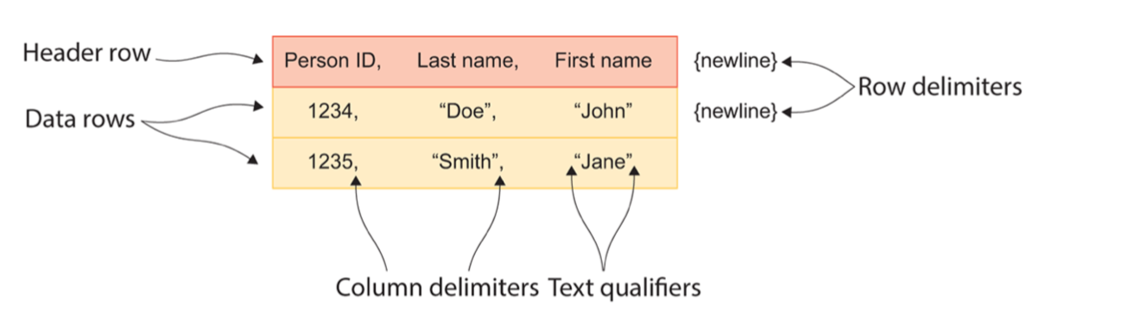
Notes:
A header row is simply the use of the first row to specify names of columns.
Person ID, Last Name, and First Name aren’t descriptions of a person; -- they are metadata describe the data structure.
It is not required – helpful in communicating what your data structure supposed to hold.
Text qualifiers are yet another type of special character used to denote that the contents of the column is a text string.

Slide 59
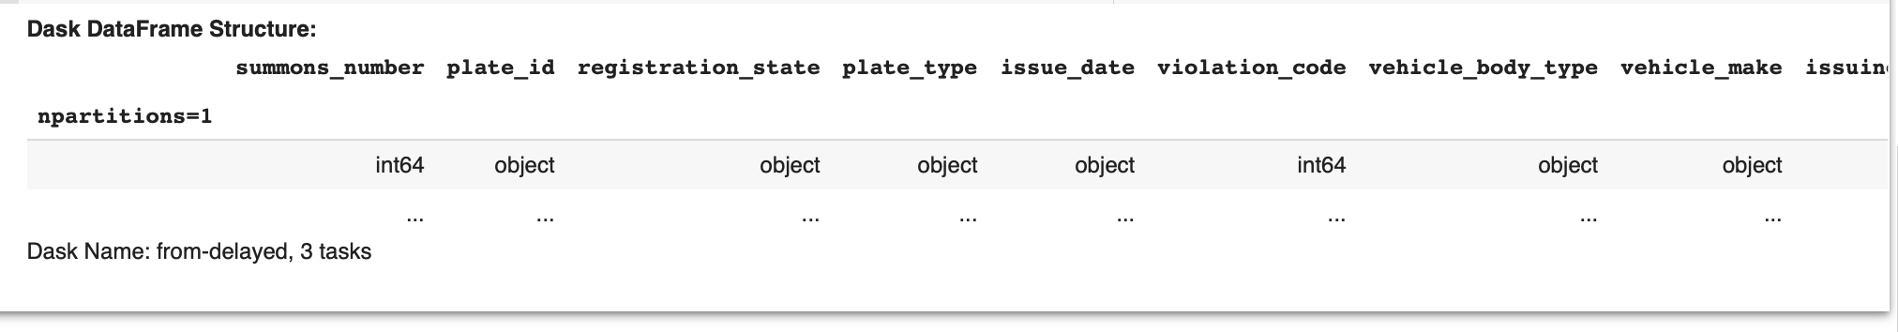
Go to dask4.ipynb
Look at the metadata of the data frame
Notes:
If you import the csv, using default size of 64M, there should be 33 partitions.
Since I am reading from https, it couldn’t determine the file size, so the partition is 1.
I can repartition later

Slide 60
Common columns
intersection method of set objects that returns a set containing the items that exist in both of the sets it’s comparing.
Wrapping this in a reduce function, we’re able to walk through each DataFrame’s metadata, pull out the columns that are
common to 2 DataFrames, and discard any columns that aren’t found in all four DataFrames.
What we’re left with is the following abbreviated list of columns
Homework: look at common columns among all 4 data frames

Slide 61
Dask cannot infer data types
unregistered_vehicle column failed to be read correctly because their datatypes were not what Dask expected.
Dask uses random sampling to infer datatypes to avoid scanning the entire (potentially massive) DataFrame.
this usually works well, it can break down when a large number of values are missing in a column or the vast majority of data can be classified as one datatype (such as an integer),
Dask will throw an exception once it begins to work on a computation.

Slide 62
Using Dask datatypes
column datatypes play an important role in Dask DataFrames.
control what kind of operations can be performed on a column, how overloaded operators (+, -, and so on) behave
how memory is allocated to store and access the column’s values
Dask DataFrames use explicit typing rather than duck typing.
all values contained in a column must conform to the same datatype
Dask will throw errors if values in a column are found that violate the column’s datatype.

Slide 63
Reading data from SQL Database

Slide 64
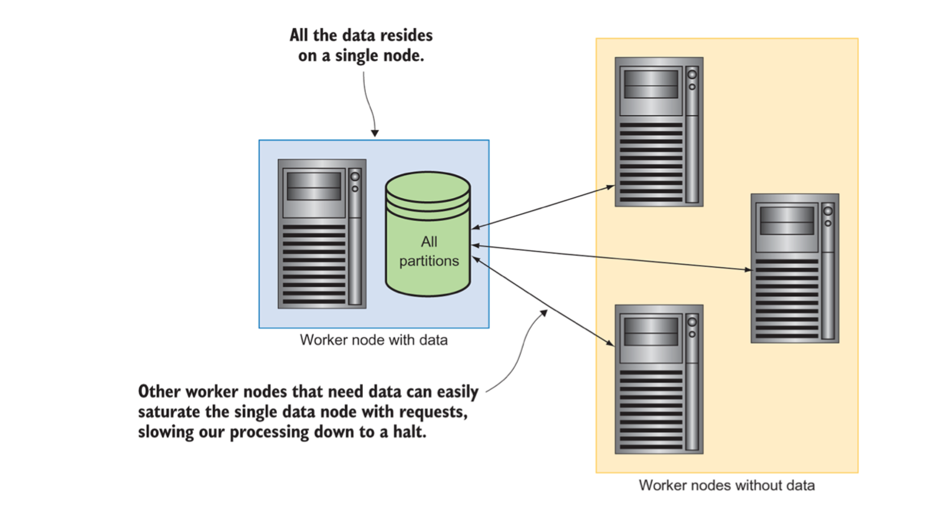
Reading data from HDFS and S3
1. Running a distributed computation without a distributed filesystem
Notes:
HDFS – Hadoop distributed file system. nodes are aware of data locality, allowing computations to be shipped to the data rather than the data shipped to the compute resources.
S3 – Amazon simple storage system
A significant bottleneck is caused by the need to chunk up and ship data to the other nodes in the cluster. Under this configuration, when Dask reads in the data, it will partition the DataFrame as usual, but the other worker nodes can’t do any work until a partition of data is sent to them.

Slide 65
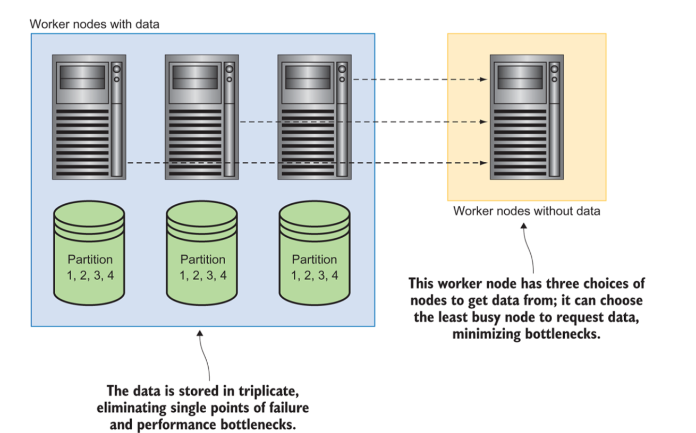
2. Running a distributed computation on a distributed filesystem

Slide 66
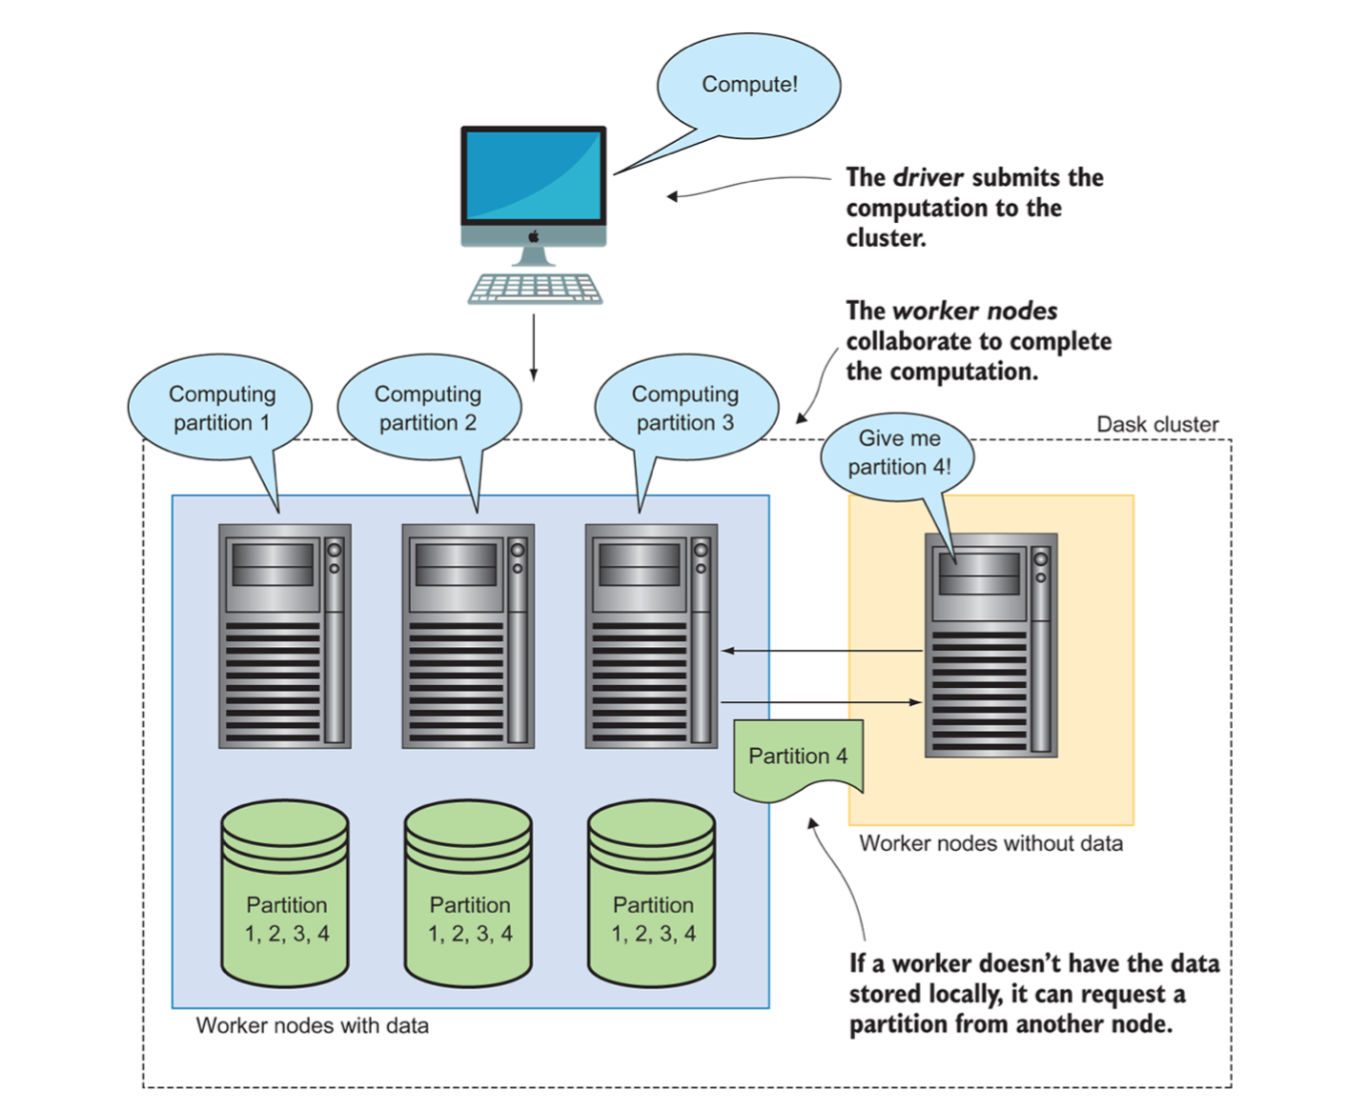
3. Shipping computation to the data

Slide 67
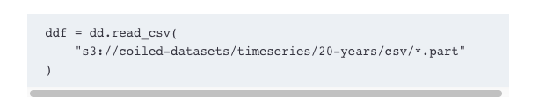

Slide 68

Connect client to remote cluster

Slide 69
Convert data to parquet from S3
ddf.to_parquet("s3://coiled-datasets/timeseries/20-years/parquet", engine=”pyarrow”)

Slide 70
Notebook
Code notebook: www.manning.com/books/data-science-with-python-and-dask and also at http://bit.ly/daskbook.
Use Jupyter notebook

Slide 71
reference
Dask.org
O’Reilly - Data science with Dask
Dask at DataCamp
O'Reilly Dask Definitive Guide

